Slide 1
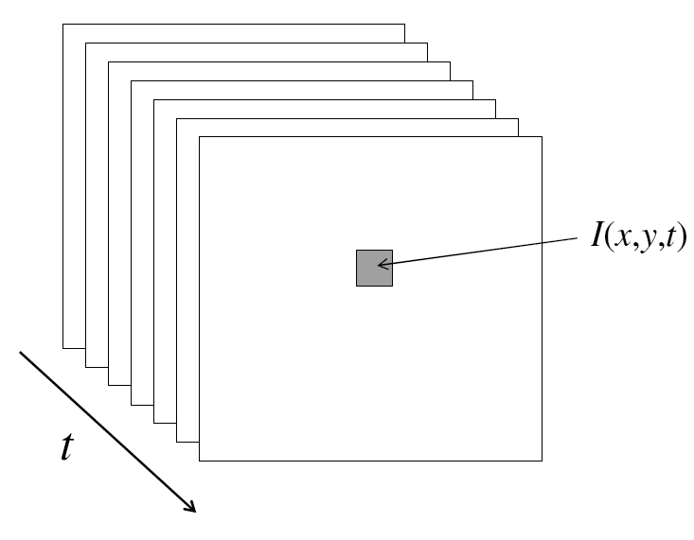
Video
A video is a sequence of frames captured over time
Now each frame/image is a function of space (x, y) and time (t)

Slide 6
Understanding the assumption
Extended reading: Taylor expansion

Slide 7
Understanding the assumption

Slide 8
What’s Next: Another way of deriving the equation

Slide 9

Imagine there is this (ramp) pattern of Intensity (image brightness) being viewed from above.

Slide 10
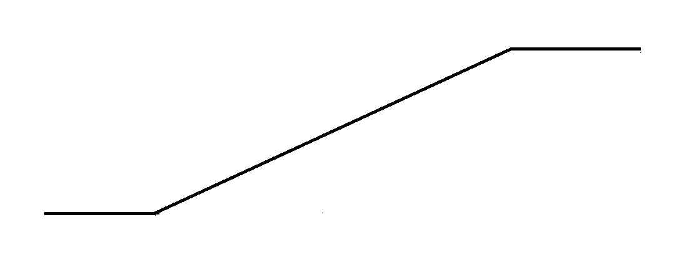
The ramp’s pattern of brightness (Intensity Profile) can be viewed as a plot.

Slide 11
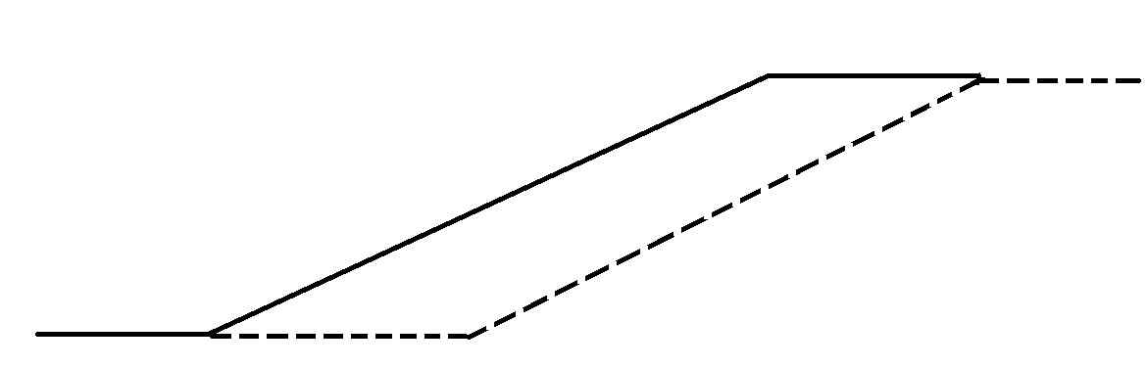
Now, Suppose the pattern moves to the right.
Dotted line shows where pattern has moved to, within unit time.

Slide 12
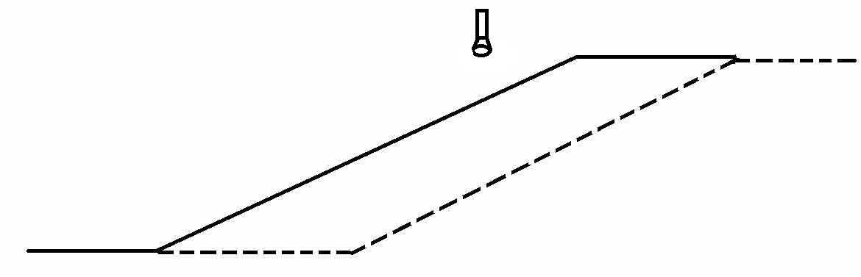
Now, Suppose a Single Pixel Camera saw this

Slide 13
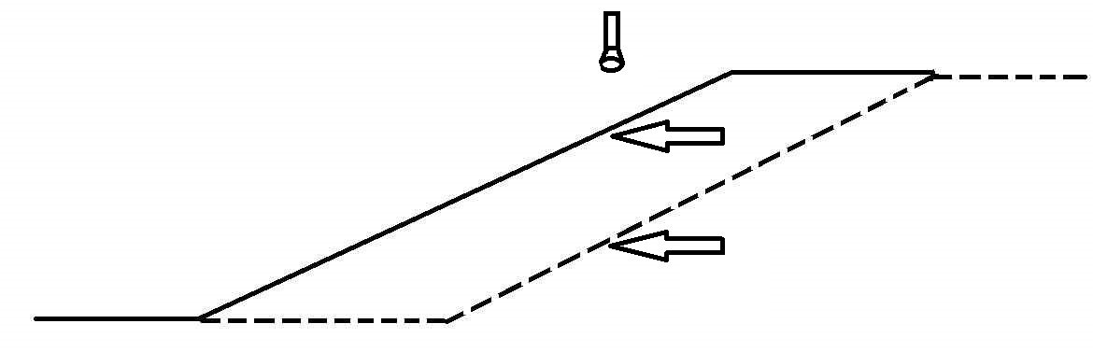
The Sensor would see the brightness change
The 2 arrows show what two brightnesses the detector sees

Slide 14
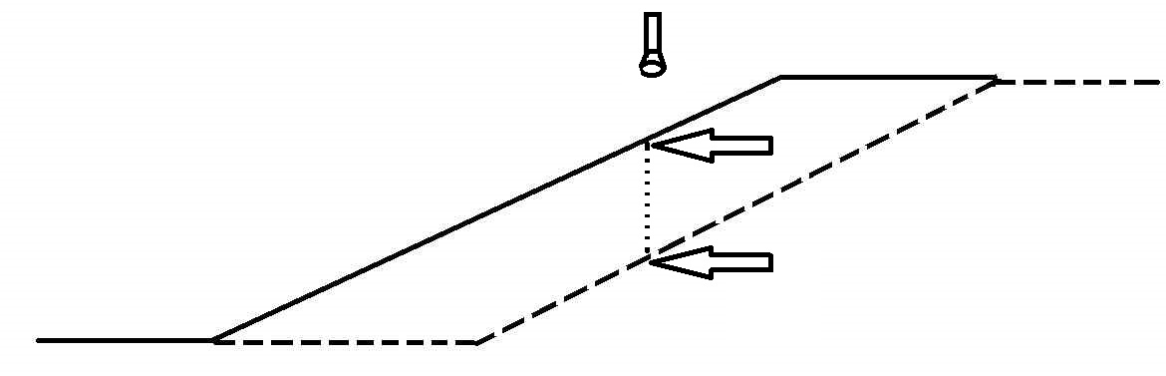
The Sensor would see the brightness change
The Dotted segment shows the amount of brightness drop.

Slide 15

The Sensor would see the brightness change
The brightness drop is given by the distance between A and B.

Slide 16
What physical properties of this situation will
determine how much brightness drop happens?

Slide 17
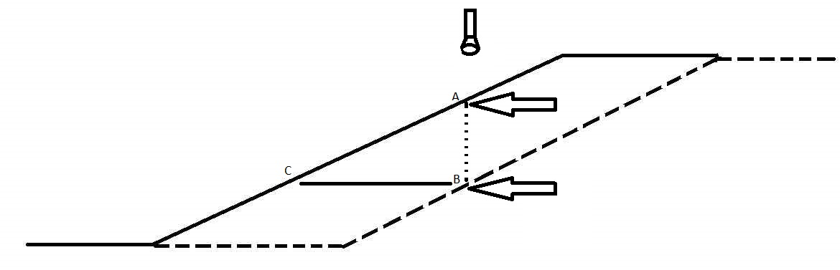
One factor contributing to the quantity of the brightness drop, is the speed.
Speed is given by the lowermost dashed segment, which is the same as the length of the segment CB.

Slide 18
One contributing factor is the speed.
Make sure you understand that the faster speed will give a bigger drop, while slower speed will give smaller drop.

Slide 19
Second contributing factor is the ramp’s slope.
Make sure you understand that the steeper slope will give a bigger drop, while shallower slope will give a smaller drop.

Slide 20
So, drop proportional to ramp’s slope & speed
Let us give symbols to these quantities, so we can work them.
The ramp itself is labeled I(x), for image or intensity function, varying along x. Speed is labeled u. Drop is labeled Iᵼ. Slope is labeled Iₓ.
Iₓ: Slope
Iᵼ: The observed Drop
u: speed

Slide 21

Describe slope in math

Slide 22
So, drop proportional to ramp’s slope & speed
So, - Iᵼ = u ∙ Iₓ
Iₓ: Slope
Iᵼ: The observed Drop
u: speed

Slide 23
Now, we need to derive a similar equation for the vertical direction.
So, similar reasoning: Suppose the region has variation only in the y-direction (not shown here, the original pattern is shown, you must imagine the new pattern); suppose that the motion is in the vertical direction (called v, now), suppose there is a single pixel sensor (camera) placed over the center of the pattern.
Then, by similar reasoning as before, we get that: - Iᵼᵧ = v ∙ Iᵧ
We had written Iᵼ earlier, when we only had one dimension to play in. Now, to keep things separate, we say Iᵼᵧ , by which we mean the drop seen by the sensor, but only that portion of the drop that is due to vertical aspects of this problem (in the original equation, to describe the horizontal behavior, we will now be using Iᵼₓ.) In the new equation here, the meaning of Iᵧ should be obvious, it is the vertical component of the image gradient.

Slide 24
In practice, the motion could be along both x and y.
So, sum the “drops”,
(- Iᵼₓ) + (- Iᵼᵧ) = u ∙ Iₓ + v ∙ Iᵧ
The terms on the Left are to be combined into one term Iᵼ.
- Iᵼ = u ∙ Iₓ + v ∙ Iᵧ
This is a famous equation in the field of Computer Vision, and it has several names:
2d motion Equation
Image motion Equation
Optical Flow Equation (this term is from perceptual psychology)

Slide 25
Comparing with the first way of deriving the optical flow equation

Slide 26
What does the 2d Motion Equation mean?
We have
- Iᵼ = u ∙ Iₓ + v ∙ Iᵧ
And we would like to estimate the motion (u, v) for every pixel.
Knowns:
Iᵼ: measured by subtracting the measurement of brightness at a fixed pixel
Iₓ, and Iᵧ: They can all be measured by other means (gradient of image, and the temporal derivative, Iᵼ, which is.
Unknowns:
u and v

Slide 27
Measuring the knowns
Iₓ
Iᵧ
Iᵼ

Slide 28
What does the 2d Motion Equation mean?
We have
- Iᵼ = u ∙ Iₓ + v ∙ Iᵧ
So, we have one equation in two unknowns, u and v.
Math tells us that the only way to get answers for this is to have a second equation with the same unknowns.
That means we need to have another single pixel camera, that can produce a second equation (for a position somewhere nearby to the first position), and we must be able to make the assumption that the two observed positions are watching two different points that are moving with the identical motion (i.e., the first point is moving with components u and v, and the second point is also moving with the same pair of motion components).

Slide 29
What does the 2d Motion Equation mean?
So, if we have
- Iᵼᴾ¹ = u ∙ Iₓᴾ¹ + v ∙ Iᵧᴾ¹ where the
superscript P1 is being used
to denote that the
measurements are coming
from a position labeled P1,
and a 2ᴺᴰ equation
- Iᵼᴾ² = u ∙ Iₓᴾ² + v ∙ Iᵧᴾ² , from P2,
then, when can we solve this?

Slide 30
What does the 2d Motion Equation mean?
So, if we have
- Iᵼᴾ¹ = u ∙ Iₓᴾ¹ + v ∙ Iᵧᴾ¹
- Iᵼᴾ² = u ∙ Iₓᴾ² + v ∙ Iᵧᴾ²
then, when can we solve this? Recall eigen analysis.
We can solve for u and v, exactly when ( Iₓᴾ¹ , Iᵧᴾ¹ ) is different from
(Iₓᴾ² , Iᵧᴾ² ). Each pair is the image gradient at the respective point. So,
if the gradient vectors are different, we can solve. Not being different,
means that we have only one edge direction even though we have two
points. So, it is pretty clear: we can only solve if we have two
independent edge directions, from which the two observed points
come. So, getting both points on the same straight edge is a bad idea.

Slide 31
- Iᵼ = u ∙ Iₓ + v ∙ Iᵧ
One equation, two unknowns (u and v)
Why cannot we get the solution for (u,v) from one equation?

Slide 32
What does the 2d Motion Equation mean?
Now that we know what having two equations does for us,
we can ask “what information is contained in one equation?”
Let us examine a single equation closely and carefully.
- Iᵼ = u ∙ Iₓ + v ∙ Iᵧ
In the equation here, we notice that the right hand side is
simply a dot-product, also called scalar-product, (or in my
terminology) a one-step convolution. So, let us write it like
that:
- Iᵼ = [ ] ∙ [ ]
u
v
Iₓ
Iᵧ

Slide 33
What does the 2d Motion Equation mean?
So, writing the equation in the form
- Iᵼ = [ ] ∙ [ ]
shows us that the Right Hand Side simply is the dot product of two vectors, which are 1) the total 2d motion vector (u,v), and 2) the image gradient vector (Iₓ , Iᵧ ). Let these be denoted by ѵ̅ (2d motion vector having components u and v), and V̅͞ I (image gradient vector having components Iₓ and Iᵧ )
u
v
Iₓ
Iᵧ

Slide 34
What does the 2d Motion Equation mean?
So, we now have
- Iᵼ = ѵ̅ . V̅͞I
Now, what we have here is a Dot Product (scalar product) of two vectors. The single step convolution expansion was where this dot product came from. i.e., that single step convolution was one way to have expanded the dot product. However, there is another way to do this expansion, and that is by writing it as
- Iᵼ = ǁ ѵ̅ ǁ x ǁ V̅͞I ǁ x Cos (θ )

Slide 35
What does the 2d Motion Equation mean?
Our equation has become:
- Iᵼ = ǁ ѵ̅ ǁ x ǁ V̅͞I ǁ x Cos (θ )
Now, pulling all the knowns to the right, and all the unknowns to the left, this can be re-written as:
ǁ ѵ̅ ǁ x Cos (θ ) = - Iᵼ / ǁ V̅͞I ǁ
Note that we have done an interesting trick here. We have pulled all known quantities to the right. That means that what remains on the left can now be computed (from the right). So, we can ask, “what is this new thing we have become able to compute?”
i.e., this thing on the left, what exactly is it? (we know now how to compute it, but we want to know “what does it represent?”)

Slide 36
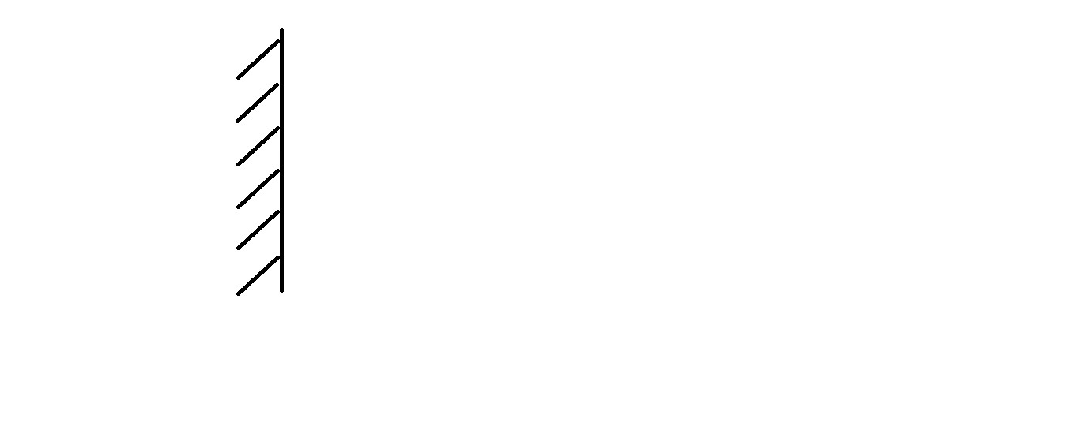
What does the 2d Motion Equation mean?
“what does the vCosθ term represent?”
We need to look at a figure: Consider an edge, that has the dark part on the left.

Slide 37
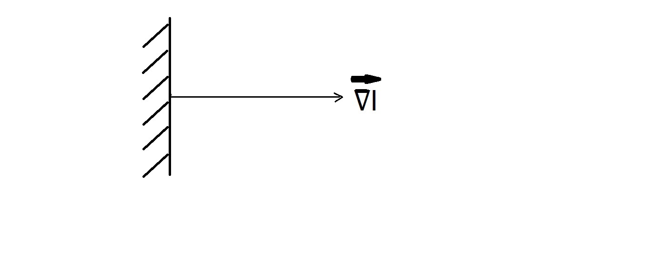
What does the 2d Motion Equation mean?
“what does the vCosθ term represent?
So, for this edge, we draw in the Gradient Vector.

Slide 38
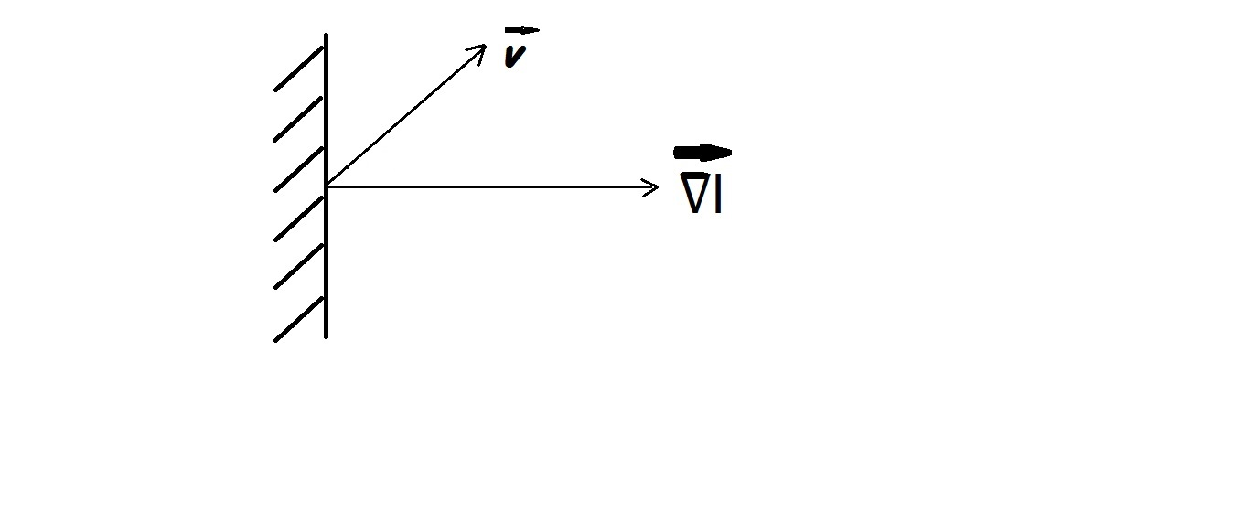
What does the 2d Motion Equation mean?
“what does the vCosθ term represent?”
We now suppose that a particular point on the edge is moving diagonally upwards with a motion vector, ѵ̄

Slide 39
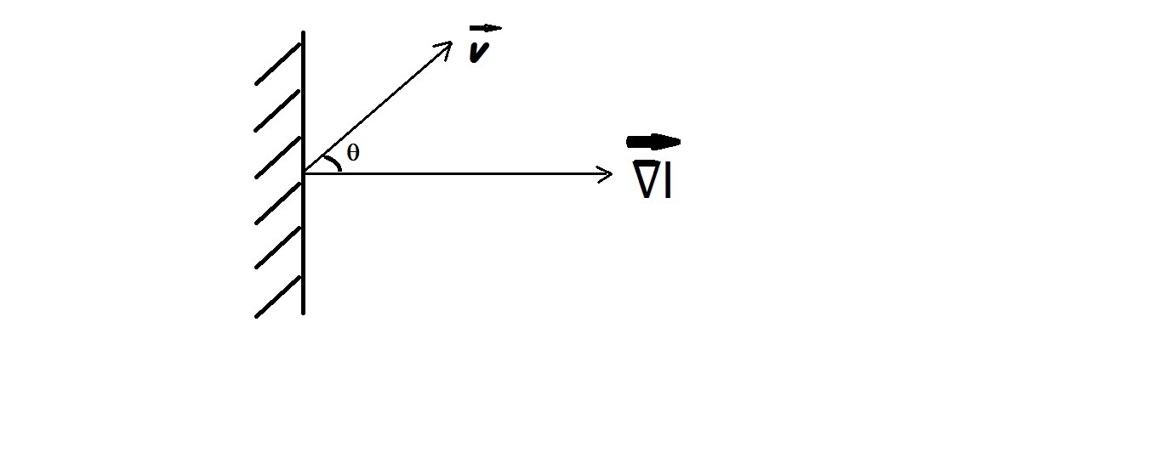
What does the 2d Motion Equation mean?
“what does the vCosθ term represent?”
We now note that the angle between the motion vector, ѵ̄ ,
and the gradient vector is θ, as shown in the figure

Slide 40
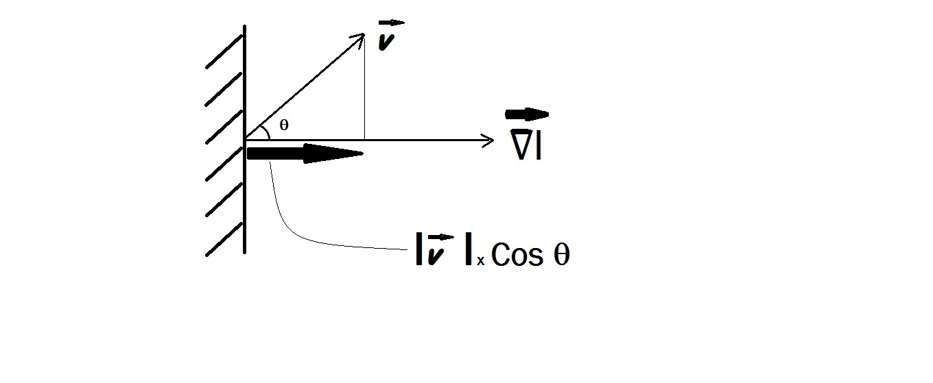
What does the 2d Motion Equation mean?
We now see that, the quantity of interest, namely, |v|Cosθ,
is merely the “perpendicular drop” from v onto the gradient
vector (sometimes also called the perpendicular projection,
or “shadow”) as shown by the thick arrow in the figure.

Slide 41
What does the 2d Motion Equation mean?
This is an important insight. It says that no matter how much there is of the component ALONG the EDGE, the only part of motion that is measureable is the component that is Normal (i.e., perpendicular) to the edge. This part is |v|Cosθ. The other part, the motion along the edge, is lost,
if one is able to view only one edge in one’s small window.
We now look at a simple demo of this concept.

Slide 42

Black Stripe moves to the right

Slide 43

Black Stripe moves to the right

Slide 44

When covered, its perceived as moving Perpendicular to edge !!!

Slide 45

When covered, its perceived as moving Perpendicular to edge !!!

Slide 46
Aperture Problem demo is DONE
So, we understand that a single equation cannot solve for answers.
A single equation only provides the component of motion that is perpendicular to the edge. The component that is ALONG THE EDGE is lost. This makes sense; try sliding a black rectangular shape , along the direction of its longer side when viewed thru a small window , similar to the type of small RED covering we used; the motion will not be visible.
Had we tracked a corner viewed thru the RED covering’s aperture, the true direction of motion becomes readily perceptible. This is because the corner has two edge directions, so this is equivalent to providing a second (independent, because its gradient is different from the first equation’s) equation.
In practice, more than two equations are used to get 2d-motion.

Slide 47
Having 3 or more locations to measure
We must assume that the three (or more) locations are coming from different gradients, so that the equations are independent.
With exactly two equations, the solution technique is the straightforward one, just simply invert the 2x2 matrix, and obtain the solution for (u,v). However, for this to be reliable, the two gradients and two temporal derivative calculations would have had to have been perfect.
It is better to use many locations and then to use some form of averaging, or least squares solution.

